Slide 1
STYLE ANALYSIS
The Five Elements

Slide 2
TONE
STYLE ANALYSIS
S
Y
N
T
A
X
O
R
G
A
N
I
Z
A
T
I
O
N
D
I
C
T
I
O
N
D
E
T
A
I
L
P
O
V

Slide 3
TONE
Speaker’s attitude
Expressed in adjectives
Usually 2 adjacent tones in passage
Controls passage

Slide 4
DICTION
Connotative words
Figurative language such as metaphor, simile
personification
Select 3 examples for each tone word

Slide 5
DETAIL
The facts
What can be perceived through the 5 senses
Who, what, when, where

Slide 6
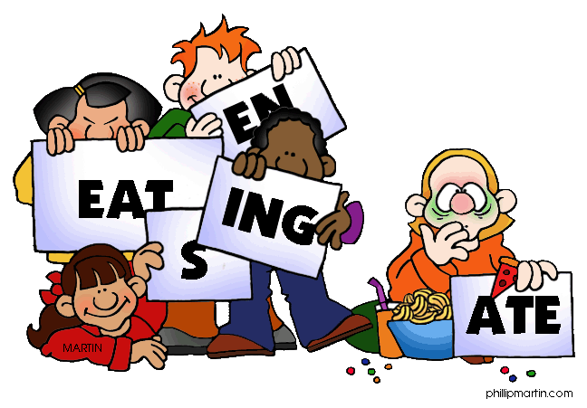
SYNTAX
The way words and phrases are arranged to form sentences.
Includes grammar, punctuation

Slide 7
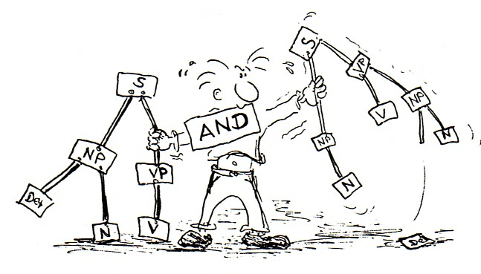
SYNTAX (CONT’D)
Sentence types
Declarative
Imperative
Interrogative
Exclamatory
Sentence structure
Simple
Compound
Complex
Compound/Complex

Slide 8
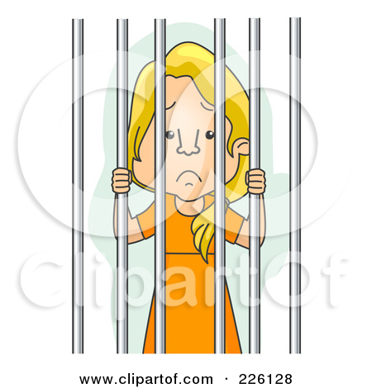
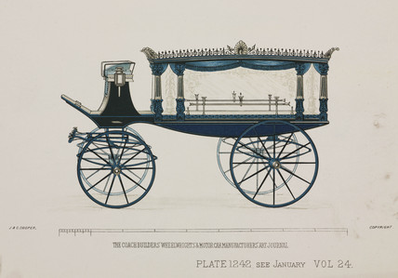
SYNTAX (CONT’D)
Word Order: Loose
Main clause’s subject, verb near the beginning of the sentence.
Jane escaped from prison before the sheriff had filled out the paper work.
Word Order: Periodic
The main clause and point of the sentence come near the end.
“Because I could not stop for death, he kindly stopped for me.”

Slide 9
POINT OF VIEW
More than 1st, 3rd limited or 3rd omniscient
The speaker’s angle on his topic, sometimes called “narrative perspective”

Slide 10
ORGANIZATION
The broader structure or framework in a piece of writing
Frame story (Ethan Frome, Wuthering Heights)
Chronological ( The Adventures of Huckleberry Finn)
Multiple Narrators (Catch 22)
Epistolary (The Color Purple)
Intercalary (Moby Dick)

